Slide 1
Chapter 2
Object Oriented Design Concepts

Slide 2
Outline
Abstract types
Interfaces
Polymorphism
Delegation vs. sub classing (Inheritance)
Generics

Slide 3
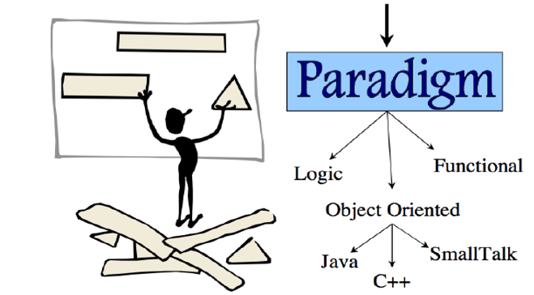
Software Design Paradigm

Slide 4
Functional Paradigm
We think in terms of functions acting on data
Abstraction: think of the problem in terms of a process that solves it
Decomposition: break your processing down into small manageable processing units(functions)
Organization: set up functions so that they call each other (function calls, arguments etc.)
FIRST: define your set of data structures(type etc.)
THEN: define your set of functions acting upon the data structures

Slide 5
Object Oriented Paradigm
We think in terms of objects interacting
Abstraction: think in terms of independent agents(objects) working together.
Decomposition : define the kinds of objects on which to split the global task
Organization: create the appropriate number of objects of each kind
FIRST: define the behavior and properties of objects of the different kinds we have defined
THEN: set up objects of each kind and put them to work

Slide 6
Object Oriented Scope
OBJECT-ORIENTED ANALYSIS: Examines the requirements of a system or a problem from the perspective of the classes and objects found in the vocabulary of the problem domain.
OBJECT-ORIENTED DESIGN: Architectures a system as made of objects and classes, specifying their relationships (like inheritance) and interactions.
OBJECT-ORIENTED PROGRAMMING: A method of implementation in which programs are organized as cooperative collections of objects, each of which represents an instance of some class, and whose classes are all members of a hierarchy of classes.

Slide 7
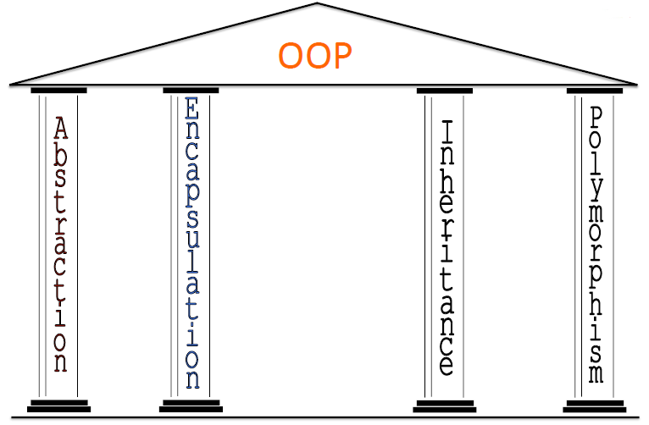

Slide 8
Abstract Data Types
Data abstraction, or abstract data types, is a programming methodology where one defines not only the data structure to be used, but the processes to manipulate the structure like process abstraction, ADTs can be supported directly by programming languages
To support it, there needs to be mechanisms for
defining data structures
encapsulation of data structures and their routines to manipulate the structures into one unit
-by placing all definitions in one unit, it can be compiled at one time
information hiding to protect the data structure from outside interference or manipulation
the data structure should only be accessible from code encapsulated with it so that the structure is hidden and protected from the outside
objects are one way to implement ADTs, but because objects have additional properties.

Slide 9
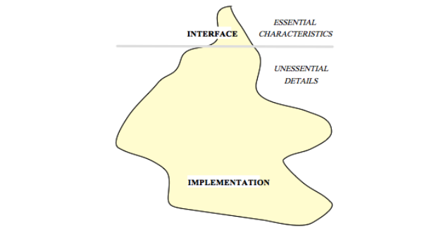
Abstraction
Abstraction allows designers to focus on solving a problem without being concerned about irrelevant lower level details.
Abstraction manages complexity by emphasizing on essential characteristics and leaving implementation details

Slide 10
Common types of abstraction
Procedural abstraction
e.g., closed subroutine
Data abstraction
e.g., ADT (Abstract Data Type) classes
Control abstraction
e.g., loops.

Slide 11
Abstraction (contd.)
Allows postponement of certain design decisions that occur at various levels of analysis
e.g.,
• Representational and algorithmic considerations
• Architectural and structural considerations
• External environment and platform considerations
The two basic abstraction types:
• Procedural abstraction
Ø abstractions of the events in the system.
Ø consists of named sequence of events
• Data abstraction
Ø named collection of data objects

Slide 12
Abstraction in Object Oriented Programming (OOP)
In OOP, Objects are the main means of abstraction
An object identifies specific entities.
- An object is either an abstract (conceptual) or concrete entity.
An object is defined by:
– Attributes (data)
– Operations
– Identity
does not depend on the current value of the attributes
This never changes
A class represents a set of objects that share a common structure and a common behavior

Slide 13
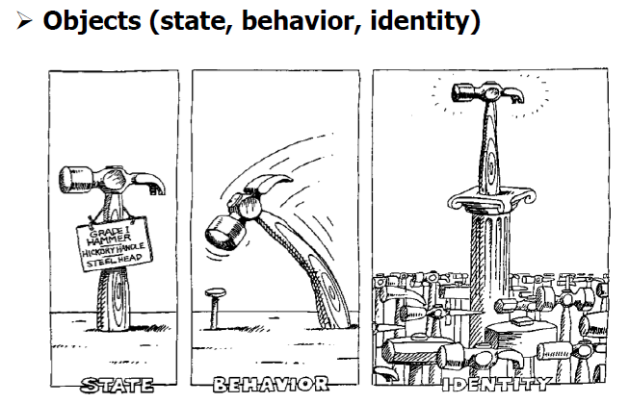
Cont’d
Examples:
Time
– Data: (Hour, Minute, Second, Date)
– Operations: add time interval, calculate difference from another period of time, etc.
– Acts (event)- for example: Measurement of a patients’ fever
Data: temperature, Measured by, Time
Operations: Print, update, archive
At a given time, each object has:
– State: the current value of the attributes
– Behavior: the set of operations they recognize, and the way they are interpreted
- Identity: a constant that is determined independently the object is said to occupy a unique expanse in memory

Slide 14
Abstract Classes & Interfaces
Definitions
– Abstract methods = Methods that are declared, with no implementation
– Abstract class = A class with abstract methods, not meant to be instantiated
– Interface = A named collection of method definitions (without implementations)
Examples
– Food is an abstract class. Can you make an instance of food? No, of course not. But you can make an instance of an apple or a steak or a peanut butter cup, which are types of food. Food is the abstract concept; it shouldn’t exist.
– Skills are interfaces. Can you make an instance of a student, an athlete or a chef? No, but you can make an instance of a person, and have that person take on all these skills. Deep down, it’s still a person, but this person can also do other things, like study, sprint and cook.

Slide 15
Abstract Classes & Interfaces
Q: So what is the difference between an interface and an abstract class?
A:
– An interface any methods, whereas an abstract class can
– A class can implement many interfaces but can have only one superclass (abstract or not)
– An interface is not part of the class hierarchy. Unrelated classes can implement the same interface
Syntax:
– abstract class:
– Public abstract class Food { }
public class Apple extends Food { … }
– interface:
public class Person implements Student, Athlete, Chef
{….}

Slide 16
Abstract Classes & Interfaces…
Q: Why are they useful?
A: By leaving certain methods undefined, these methods can be implemented by several different classes, each in its own way.
Example: Chess Playing Program
– an abstract class called ChessPlayer can have an abstract method makeMove(), extended differently by different subclasses.
public abstract class ChessPlayer {
<variable declarations>
<method declarations>
public void makeMove(); }
– an interface called ChessInterface can have a method called makeMove(), implemented differently by different classes.
public interface ChessInterface {
public void makeMove(); }

Slide 17
The Object Concept
An object is an encapsulation of data.
An object has:
1.An identity (a unique reference)
e.g.: Social security number (SSN), employee number, passport
number, Student number
Account a = new Account()
2.State, also called characteristics (variables)
e.g.: hungry, sad, drunk, running, alive
3.Behavior (methods)
e.g.: eat, drink, smile, kiss and wave.
An object is an instance of a class.
A class is oden called an Abstract Data Type (ADT).

Slide 18
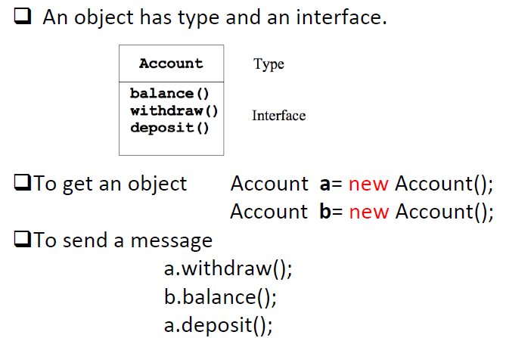
Type and an Interface of Object

Slide 19
The Object Concept
A class is a collection of objects (or values) and a corresponding set of methods.
A class encapsulates the data representation and makes data access possible at a higher level of abstraction.
A class defines a template of the similar objects.

Slide 20
Class Vs. Object
Class
A description of the common properties of a set of objects.
A concept.
A class is a part of a program.
Object
A representation of the properties of a single instance.
A real world entity.
An object is part of data and a program execution.

Slide 21
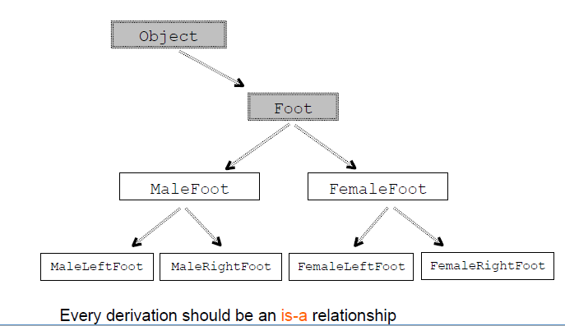
Cont’d
Inheritance may be used to define a hierarchy of classes in an application:

Slide 22
Polymorphism
Polymorphism comes from Greek meaning “many forms.”
In Java, polymorphism refers to the dynamic binding mechanism that determines which method definition will be used when a method name has been overridden.
Thus, polymorphism refers to dynamic binding.
The ability of a function to respond differently when supplied with arguments that are objects of different types is called functional overloading.
Polymorphism ensures that the appropriate method is called for an object of a specific type when the object is disguised as a more general type.
A polymorphic reference is a variable that can refer to different types of objects at different points in time.

Slide 23
Polymorphism (Cont’d)
Can treat an object of a subclass as an object of its superclass
– A reference variable of a superclass type can point to an object of its subclass
Person name, nameRef;
PartTimeEmployee employee, employeeRef;
name = new Person("John", "Blair");
employee = new PartTimeEmployee("Susan", "Johnson",
12.50, 45);
nameRef = employee;
System.out.println("nameRef: " + nameRef);
nameRef: Susan Johnson wages are: $57.50

Slide 24
Polymorphism (Cont’d)
Late binding or dynamic binding (run-time binding):
– Method to be executed is determined at execution time, not compile time
Polymorphism: to assign multiple meanings to the same method name
Implemented using late binding
Polymorphism: Enables “programming in the general”
--The same invocation can produce “many forms” of results
Polymorphism promotes extensibility of the design in OOD.

Slide 25
Polymorphism (Cont’d)
When a program invokes a method through a superclass variable,
– the correct subclass version of the method is called,
– based on the type of the reference stored in the superclass variable
The same method name and signature can cause different actions to occur,
– depending on the type of object on which the method is invoked

Slide 26
Encapsulation and Information Hiding
Data can be encapsulated such that it is invisible to the “outside world”.
Data can only be accessed via methods.

Slide 27
Encapsulation and Information Hiding…Cont..
What the “outside world” cannot see it cannot depend on!
The object is a “fire-wall” between the object and the “outside world”.
The hidden data and methods can be changed without affecting the “outside world”.

Slide 28
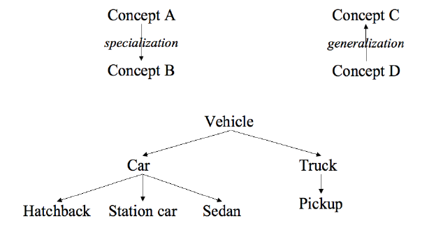
Generalization and Specialization
Generalization creates a concept with a broader scope.
Specialization creates a concept with a narrower scope.
Reusing the interface!

Slide 29
Generalization and Specialization, Example
Inheritance: get the interface from the general class.
Objects related by inheritance are all of the same type.
Square “is-a” Shape or Square “is-like-a” Shape

Slide 30
Aggregation and Decomposition
An aggregation consists of a number of (sub-)concepts which collectively is considered a new concept.
A decomposition splits a single concept into a number of (sub-)concepts.

Slide 31
Aggregation and Decomposition…
Idea: make new objects by combining existing objects.
Reusing the implementation!
Car “has-a” Gearbox and Car “has-an” Engine

Slide 32
What is Generics?
Collections can store Objects of any Type
Generics restricts the Objects to be put in a collection
Generics ease identification of runtime errors at compile time
How is Generics useful?
Consider this code snippet
List v = new ArrayList();
v.add(new String("test"));
Integer i = (Integer)v.get(0); // Runtime error .
Cannot cast from String to Integer
NOTE: This error comes up only when we are executing the program and not during compile time.

Slide 33
Thank You !

